Slide 1
HLS Final Project Report
胡晉瑄 林修賢

Slide 2
Outline
Introduction
Algorithm/Optimization
Result

Slide 3
Topics include
Team leader : 胡晉瑄
Project title: Scalable Streaming Accelerator of Graph Convolution Network

Slide 4
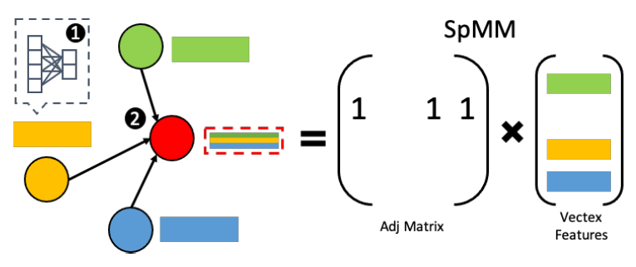
Problem Statement - Content
•Graph Convolution networks (GCNs), an emerging deep learning model class, can extract meaningful representations from highly expressive graph-structured data and are therefore gaining popularity for wider ranges of applications

Slide 5
Problem Statement - Issue
GNNs inherit both the irregular processing dataflow (aggregation) of graph analytic and the regular computing pattern of DNNs.
Sparse + Dense, Random Access
A real-world graph can be extremely huge
Need tiling mechanism
The power-law distribution of the big real-world graph
Need to balance the data access

Slide 6
Problem Statement - Objective
•Objective:
Can Handle Large-Scale Dataset. e.g. Reddit
Faster than Modern CPU

Slide 7


Block Diagram & Operation Flow
Graph Convolution Network
streaming
streaming
SPMM
DMM
Activation

Slide 8
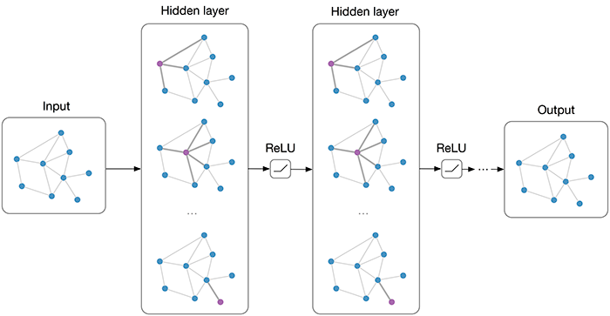
Area of Work & Platform
We would design a streaming GCN layer which Operation including sparse matrix , dense matrix and Relu.
Platform: PYNQ
Our work

Slide 9
System Implementation

Slide 10
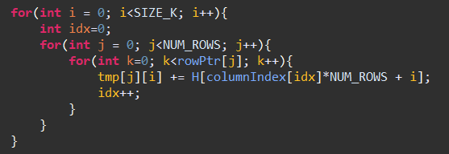
Baseline Code - SpMM

Slide 11
SpMV Computation Illustration
A
X
Y

Slide 12
SpMV Computation Illustration
A
X
Y

Slide 13
SpMV Computation Illustration
A
X
Y

Slide 14
SpMV Computation Illustration
streaming in
random access
streaming out
A_CSR
X
Y

Slide 15
SpMV Kernel Timeline
1
0
1
1
41
75
1
0
0
1
row_length: 3 2 2 4
67
41
1
0
0
1
34
41
col_index : 0 2 3 0 3 0 3 0 1 2 3
1
1
1
1
0
142
A
X
Y
r0
r1
r2
r3
X[0]
X[1]
X[2]
X[3]
R
R
R
R
41
67
34
0
0/3
2
1
0
0/2
1
0
0/2
1
0
0/4
3
2
1
0
0
W
W
W
W
Y[0]
Y[1]
Y[2]
Y[3]

Slide 16
Matrix Partition_vertically
csr1
sum
csr2
csr1
csr2
csr3
Y
A
X
csr3

Slide 17
Streaming Accumulator
Time0
y_acc_fifo
Y_out
Y0
sum
y_feedback_controler
Y0
Y1
sum
Time1
y_acc_fifo
Y_out
sum
y_feedback_controler
Y2
Y
Y1
Time2
y_acc_fifo
Y_out
sum
y_feedback_controler
Y2
Y

Slide 18
Matrix Partition_horizontally
csr1
csr2
csr3
A
X
Y

Slide 19
Matrix Tiling
csr1
csr2
csr3
csr4
csr5
csr6
csr7
csr8
csr9
A
Y
X

Slide 20
Matrix Tiling
csr1
csr2
csr3
csr4
csr5
csr6
csr7
csr8
csr9
A
Y
X

Slide 21
Matrix Tilling
Partition_vertically
x_buffer size: SIZE → SIZE / v_cut
y_buffer size: 0 → SIZE
Partition_horizontally
y_buffer size: SIZE→SIZE/ h_cut
Tilling
x read times : 1 → h_cut
x_buffer size: SIZE → SIZE / v_cut
y_buffer size: 0→SIZE/ h_cut

Slide 22
matrix spliting comparing
 | Buffer_size | Time
Naive | (x) SIZE | NNZ + SIZE +1
Partition_vertically | (x) SIZE/v_cut + (y) SIZE | NNZ + (v_cut + 1) * SIZE +1
Partition_horizontally | (x) SIZE + (y) 0/h_cut | NNZ + SIZE +1
Tilling | (x) SIZE/v_cut + (y) SIZE/h_cut | NNZ + (v_cut + h_cut + 1) * SIZE + 1

Slide 23
GEMM Implementation
Reference Paper:
Flexible Communication Avoiding Matrix Multiplication on FPGA with High-Level Synthesis
Github:
GitHub - spcl/gemm_hls: Scalable systolic array-based matrix-matrix multiplication implemented in Vivado HLS for Xilinx FPGAs.

Slide 24
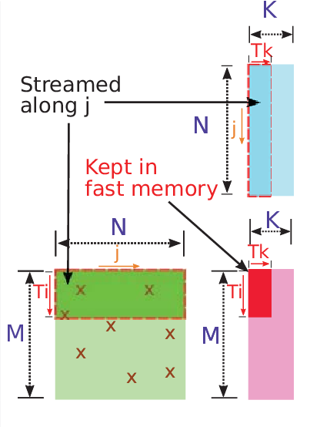
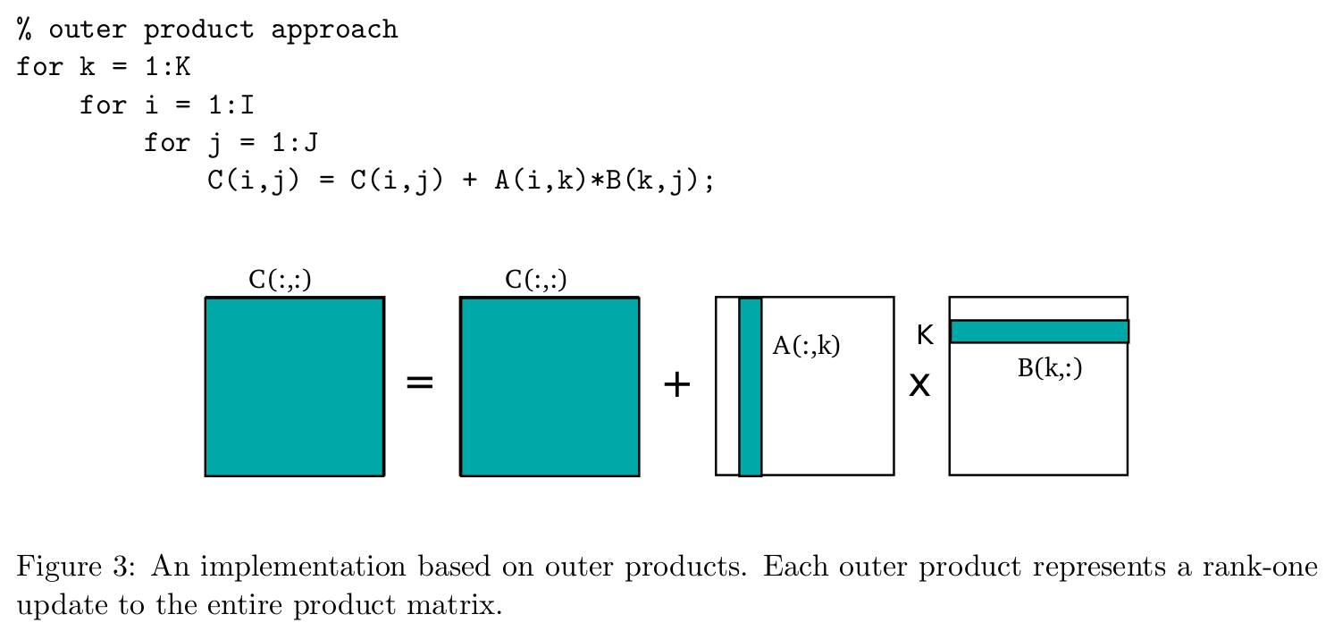
GEMM Algorithm Explain

Slide 25

GEMM Detail
PE
PE
Mul_add
Mul_add
B
C_buf
C_buf
Inner Tile
A
C
PEs
Outer Product
Outer Tile

Slide 26
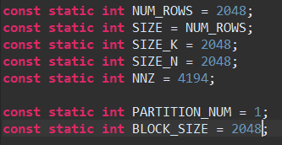
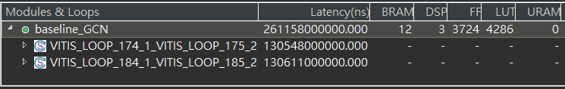
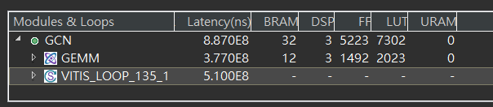
Simulation Result
SIZE=2048, NNZ =4194, Sparsity=0.1%
Naive
Ours(Partition = 1)

Slide 27
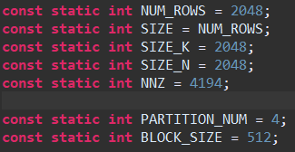
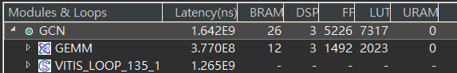
Simulation Result
SIZE=2048, NNZ =4194, Sparsity=0.1%
Ours(Partition = 4)
Ours(Partition = 1)

Slide 28
Problem We meet
variable boundery size NNZ
cosim fail

Slide 29
Problems in Cosim - 1
Probloem
Top function 'GCN’ is not invoked in the test bench
solution:
在project setting 中選擇的 top function 必須要在testbench中被呼叫

Slide 30
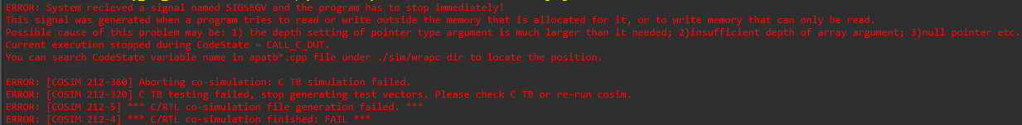
Problems in Cosim - 2
Probloem
System recieved a signal named SIGSEGV and th program has to stop immediately
solution:
如果有宣告Interface maxi 的話，在cosim也需要宣告 interface 的 depth

Slide 31
Problems in Cosim - 3
Probloem
Aborting co-simultaion: C TB simulation failed
solution:
Csim有過 但 cosim遇到這個問題，主要是因為maxi 雖然有宣告depth ，但是depth必須等於array 的 size 才可以正確運作

Slide 32
Problem in Sparse Design
Problem:
Each tile has different NNZ, so we can’t control PE like this.
Solution
Use total NNZ to control the flow, and use other information i.e. row_size to check the condition

Slide 33
Github
https://github.com/th005151/NYCU_HLS_FP_GCN

